Slide 1

Testing & Performance
Wenxuan Shi
College of Software, Nankai University
Email: shiwx@nankai.edu.cn
Wechat: 13920561100

Slide 2
Topics
Testing Flutter apps
Performance best practices

Slide 3
Testing Flutter apps
Notes:
StatelessWidget is used for immutable elements that only rely on the object configuration information
StatefulWidget is used for elements that can dynamically change based on state-changes in the system
Everytime that state changes, setChange() is called by the object

Slide 4
Testing
The more features your app has, the harder it is to test manually.
Automated tests help ensure that your app performs correctly before you publish it, while retaining your feature and bug fix velocity.
Automated testing falls into a few categories:
A unit test tests a single function, method, or class.
A widget test (in other UI frameworks referred to as component test) tests a single widget.
An integration test tests a complete app or a large part of an app.

Slide 5
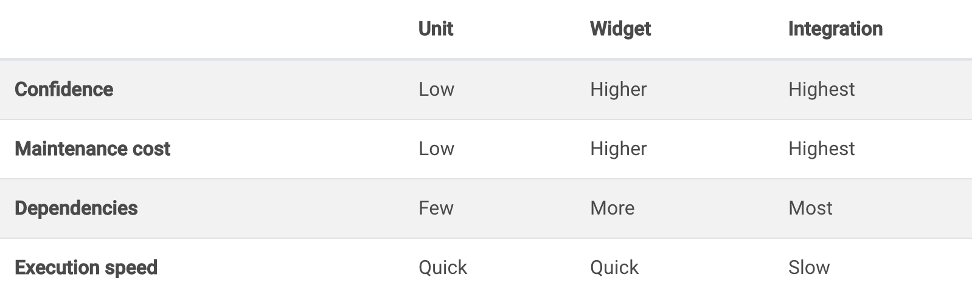
Generally speaking, a well-tested app has many unit and widget tests, tracked by code coverage, plus enough integration tests to cover all the important use cases.
This advice is based on the fact that there are trade-offs between different kinds of testing, seen below.

Slide 6
Unit tests
A unit test tests a single function, method, or class.
Unit tests generally don’t read from or write to disk, render to screen, or receive user actions from outside the process running the test.
Recipes
An introduction to unit testing
Mock dependencies using Mockito

Slide 7
Widget tests
A widget test (in other UI frameworks referred to as component test) tests a single widget.
The goal of a widget test is to verify that the widget’s UI looks and interacts as expected.
Recipes
An introduction to widget testing
Find widgets
Tap, drag, and enter text

Slide 8
Integration tests
An integration test tests a complete app or a large part of an app.
The goal of an integration test is to verify that all the widgets and services being tested work together as expected. Furthermore, you can use integration tests to verify your app’s performance.
Recipes
An introduction to integration testing
Handle scrolling
Performance profiling

Slide 9
Continuous integration services
Continuous integration (CI) services allow you to run your tests automatically when pushing new code changes.
This provides timely feedback on whether the code changes work as expected and do not introduce bugs.

Slide 10
For information on running tests on various continuous integration services, see the following:
Continuous delivery using fastlane with Flutter
Test Flutter apps on Travis
Test Flutter apps on Cirrus
Codemagic CI/CD for Flutter
Flutter CI/CD with Bitrise

Slide 11
Performance best practices
Notes:
StatelessWidget is used for immutable elements that only rely on the object configuration information
StatefulWidget is used for elements that can dynamically change based on state-changes in the system
Everytime that state changes, setChange() is called by the object

Slide 12
Introduction
Generally, Flutter applications are performant by default, so you only need to avoid common pitfalls to get excellent performance instead of needing to micro-optimize with complicated profiling tools.
These best recommendations will help you write the most performant Flutter app possible.

Slide 13
Best practices
Controlling build() cost
Avoid repetitive and costly work in build() methods since build() can be invoked frequently when ancestor Widgets rebuild.
Avoid overly large single Widgets with a large build() function. Split them into different Widgets based on encapsulation but also on how they change.

Slide 14
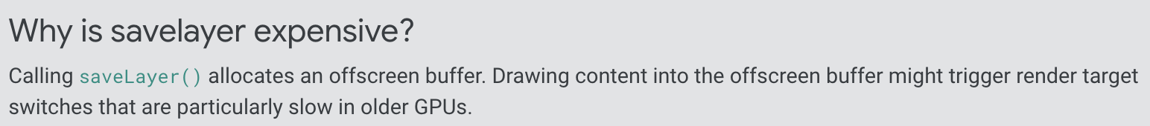
Apply effects only when needed
Use effects carefully, as they can be expensive.
Some of them invoke saveLayer() behind the scenes, which can be an expensive operation.

Slide 15
Some general rules when applying specific effects:
Use the Opacity widget only when necessary.
Clipping doesn’t call saveLayer() so these operations aren’t as expensive as Opacity, but clipping is still costly, so use with caution.

Slide 16
Other widgets that might trigger saveLayer() and are potentially costly:
ShaderMask
ColorFilter
Chip
Text

Slide 17
Render grids and lists lazily
Use the lazy methods, with callbacks, when building large grids or lists.
That way only the visible portion of the screen is built at startup time.
Also see:
Working with long lists in the Cookbook
Creating a ListView that loads one page at a time
Listview.builder API

Slide 18
Build and display frames in 16ms
Since there are two separate threads for building and rendering, you have 16ms for building, and 16ms for rendering on a 60Hz display.
If latency is a concern, build and display a frame in 16ms or less.
If you are wondering why 60fps leads to a smooth visual experience, see the video Why 60fps?

Slide 19
Pitfalls
If you need to tune your app’s performance, or perhaps the UI isn’t as smooth as you expect, the Flutter plugin for your IDE can help.
In the Flutter Performance window, enable the Show widget rebuild information check box.
This feature helps you detect when frames are being rendered and displayed in more than 16ms.

Slide 20
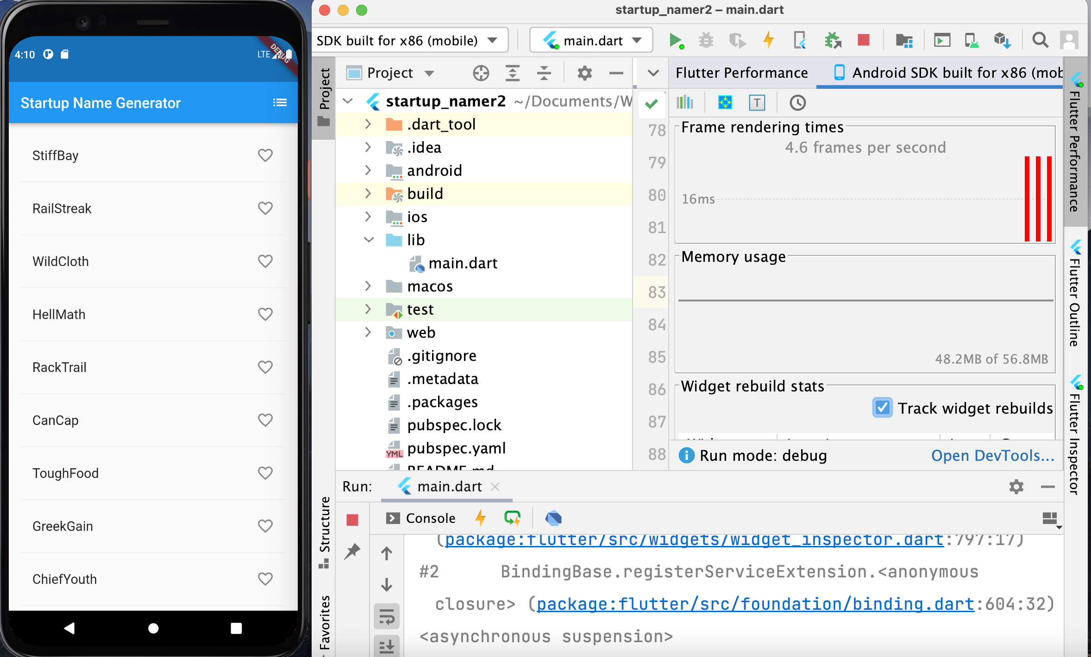

Slide 21
Resources
For more performance info, see the following resources:
Performance optimizations in the AnimatedBuilder API page
Performance considerations for opacity animation in the Opacity API page
Child elements’ lifecycle and how to load them efficiently, in the ListView API page
Performance considerations of a StatefulWidget

Slide 22
Thank you!
Wenxuan Shi
College of Software, Nankai University
Email: shiwx@nankai.edu.cn
Wechat: 13920561100

